Slide 1
Multiobjective Optimization

Slide 2

Optimization
In general, optimisation refers to the task of either minimising or maximising some function F(x) by altering x, where 'x' is input variable.
Maximisation of “prediction accuracy” or redefine the objective by saying “minimisation of the loss”.
The objective is only one, is known as Single-Objective Optimisation.
In the single-objective optimization problem, the superiority of a solution over other solutions is easily determined by comparing their objective function values.
 Involve more than one objective function that are to be minimized or maximized. 

Slide 3
Multi-Objective Optimization Problems (MOOP)
In MOOP, we try to optimise many objective functions simultaneously while trying to find a balance between all competitive objective functions without many trade-offs.
Answer is set of solutions that define the best tradeoff between competing objectives.
However, it is tough to narrow the solution search to one optimal solution since there are many feasible solutions in the solution space, and some problems have intractable solution space.
From a computational complexity stance, intractable problems are problems for which there exist no efficient algorithms to solve them.
 In multi-objective optimization problem, the goodness of a solution is determined by the dominance.

Slide 4
Definition 1
Multiobjective Optimization.
Given m objective functions f₁ : χ → ℜ ...; f_{m} : χ → ℜ which map a decision space χ into ℜ.
A multiobjective optimization problem (MOOP) is given by the following problem statement:
minimize f₁ (x) ,….. minimize f_{m} (x); x ∈ χ
m > 1, at least 2 for multiobjective optimization problems.

Slide 5
Pareto-optimal Solutions
The Presence of multiple objectives in a problem, in principle, gives rise to a set of optimal solutions (Pareto-optimal solutions), instead of a single optimal solution.
In the absence of any further information, one of these Pareto-optimal solutions cannot be said to be better than the other.
Classical optimization methods suggest converting the multiobjective optimization problem to a single-objective optimization problem by emphasizing one particular Pareto-optimal solution at a time.
When such a method is to be used for finding multiple solutions, it has to be applied many times, hopefully finding a different solution at each simulation run.

Slide 6
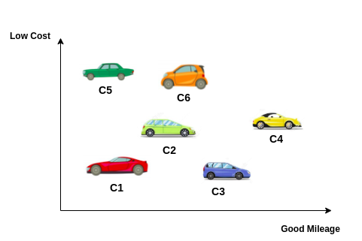
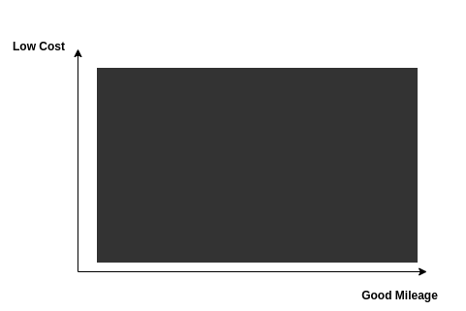
Objective 1 | Good Mileage
Objective 2 | Low-Cost
Scenario 1: Applying 1D optimisation on objective-1 i.e. Good Mileage first, followed by application of 1D optimisation on objective-2, i.e. Low-Cost.
Scenario 2: Applying 1D optimisation on objective-2, i.e. Low-Cost first, followed by applying 1D optimisation on objective-1, i.e. Good Mileage.
One more assumption: the car showroom is dark, and customer holding a torch to find the desired car, i.e. low cost & good mileage

Slide 7
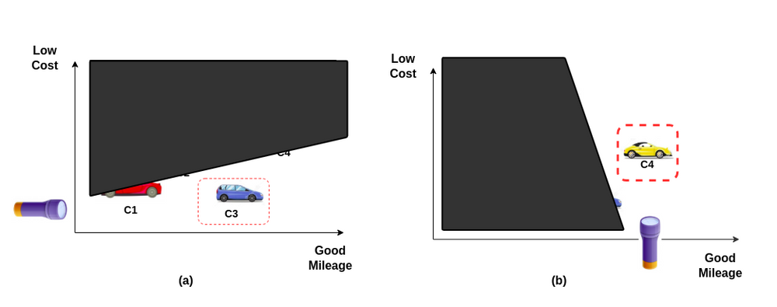
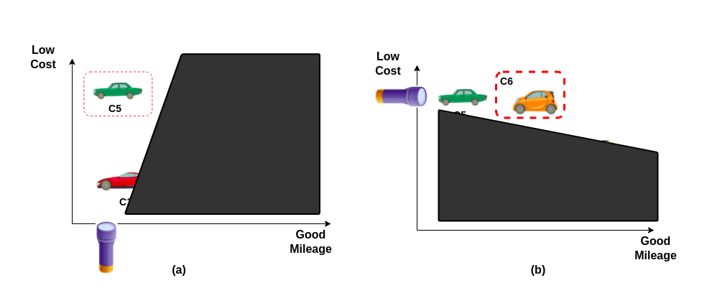
Scenario 1: Good Mileage followed by Low Cost
Scenario 2: Low-Cost followed by Good Mileage

Slide 8
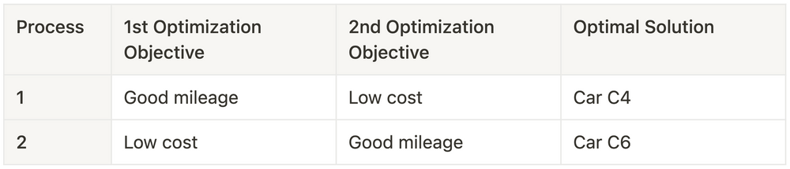
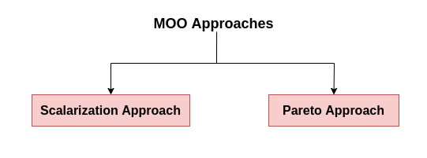
So if we choose to go with the 1D optimisation method, we might get a different solution using a different strategy.
This is the major drawback of 1D optimisation for multi-objective tasks.
Types of Multi-Objective Optimisation Approaches

Slide 9
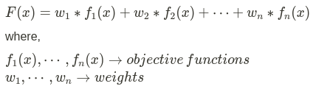
Scalarization Approach
The scalarization approach creates multi-objective functions made into a single solution using weights before optimisation.
The mathematical formulation -
The weight of the objective function will determine the optimal solution.

Slide 10
General Form of MOOP
Mathematically,
min/max f_{m} (x), m = 1,2, …M, x is a decision vector
subject to g_{j} (x) ≥ 0, j = 1, 2, …J
h_{k} (x) = 0, k = 1, 2, …K
The problem is subjected to J inequality constraints and K equality constraints.
Additionally, each variable has an upper and/or lower bound associated with it.
Lower bound
Upper bound
A solution is a vector of n decision variables :
A multi-objective technique is used to optimize two or more competing goals at the same time by considering the constraints.
A solution that satisfies all constraints and variable bounds is called a feasible solution. The set of all feasible solutions is called the feasible region, or S. The term “search space” is also used as a synonym to feasible region. The objective space is constituted by the possible values of the M objectives functions for all solutions in S.

Slide 11
Dominance
In the single-objective optimization problem, the superiority of a solution over other solutions is easily determined by comparing their objective function values.
In multi-objective optimization problem, the goodness of a solution is determined by the dominance.

Slide 12
Definition of Dominance
Dominance Test
x₁ dominates x₂, if 
Solution x₁ is no worse than x₂ in all objectives 
Solution x₁ is strictly better than x₂ in at least one objective
x₁ dominates x₂ ↔ x₂ is dominated by x₁
f₂(minimize)
2 1 Vs 2: 1 dominates 2
1 Vs 5: 5 dominates 1
1 Vs 4: Neither solution dominates
4
1 5 non-dominated front
3
f₁(maximize)
6
For a given set of solutions on the objective space, a pair-wise comparison can be made using the above definition and whether one point dominates the other can be established.

Slide 13
non-dominated point
For the set of six solutions points 3, 5, and 6 are non-dominated.
One property of any two such points is that a gain in an objective from one point to the other happens only due to a sacrifice in at least one other objective.
This trade-off property between the non-dominated points makes the practitioners interested in finding a wide variety of them before making a final choice.
These points make up a front when viewed them together on the objective space; hence the non-dominated points are often visualized to represent a non-domination front.

Slide 14
Non-dominated solution set
Given a set of solutions, the non-dominated
solution set is a set of all the solutions that are not
dominated by any member of the solution set.
The non-dominated set of the entire feasible decision space is called the Pareto-optimal set
The boundary defined by the set of all point mapped from the Pareto optimal set is called the Pareto optimal front.

Slide 15
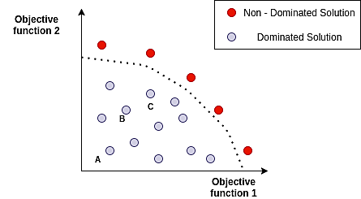
Pareto Approach
There is a dominated solution and a non-dominated solution obtained by a continuously updated algorithm in the Pareto approach.
Dominated solutions are solutions that are not the optimal ones, i.e. there exist other points which supersede that point. point 'A' is dominated by point 'B', and point 'C' dominates both 'A' and 'B'.
The solutions which cannot be dominated by any point in the feasible solution space are called 'Non-Dominated Solutions', also known as Pareto Efficient.

Slide 16
Pareto front
A solution x* is referred to as dominated by another solution x if, and only if, x is equally good or better than x* with respect to all objectives.
A set of nondominated solutions, being chosen as optimal, if no objective can be improved without sacrificing at least one other objective.
Pareto front is a set of nondominated solutions, being chosen as optimal, if no objective can be improved without sacrificing at least one other objective.
The set that corresponds to Pareto set and is composed of all Pareto optimal decision vectors is called Pareto front.

Slide 17
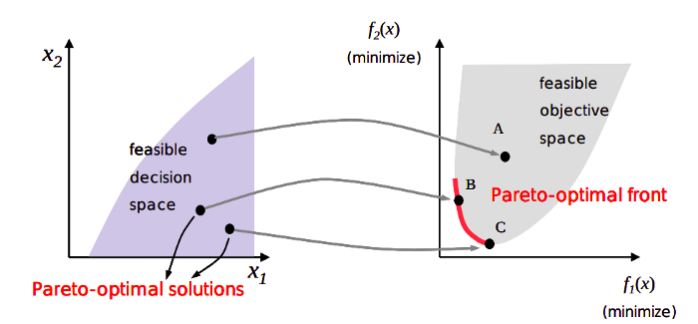
The Non-Dominated solution set is called Pareto Optimal Solutions/Set.
Pareto Front is the boundary defined by the set of all points in objective space or criterion space mapped from the Pareto Optimal Set in decision space.
Once we find the Pareto Solution, we can apply other algorithms on top of it rather than computing the intractable solution space we curtailed to a finite set.
Pareto optimal solutions are sometimes referred to as "Non-Inferior" solutions.

Slide 18
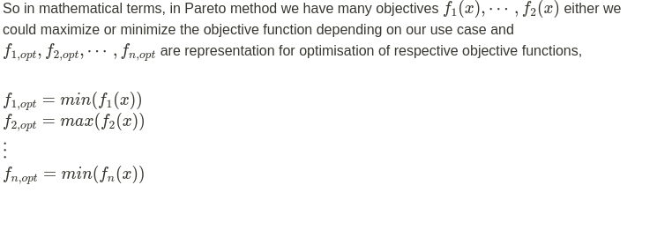
Pareto optimality is the state at which resources in a given system are optimised in a way that one dimension cannot improve without a second worsening.

Slide 19
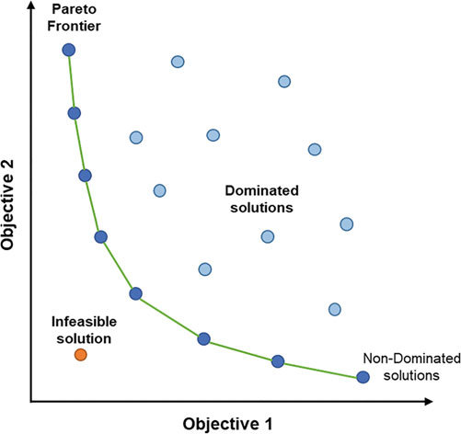

Slide 20
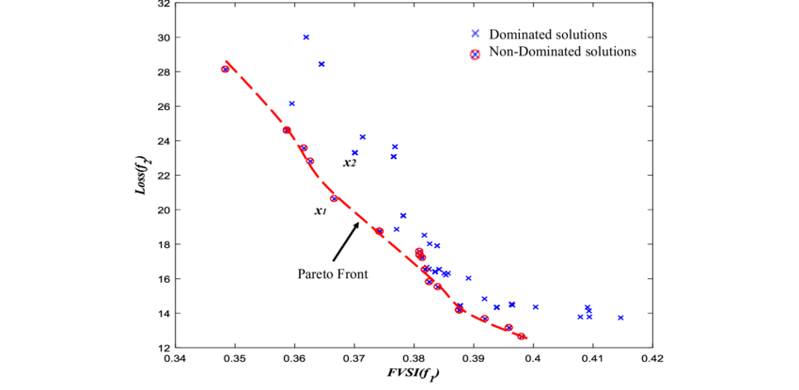
An algorithm that gives a large number of alternative solutions lying on or near the Pareto-optimal front is of great practical value.

Slide 21
Goals in MOO
1. Find a set of solutions which lie on the Pareto-optimal front, and
2. Find a set of solutions which are diverse enough to represent the entire range of the Pareto-optimal front.
Thus, in a multi-objective optimization, ideally the effort must be made in finding the set of trade-off optimal solutions by considering all objectives to be important.
After a set of such trade-off solutions are found, a user can then use higher-level qualitative considerations to make a choice.

Slide 22
Multiobjective Evolutionary Algorithms (MOEAs)
Over the past decade, a number of MOEAs have been suggested, primarily to find multiple Pareto-optimal solutions in one single simulation run.
The nondominated sorting genetic algorithm (NSGA) was one of the first such EAs.
The main criticisms of the NSGA approach-
(i) NSGA computationally expensive O(mN³) for large population sizes (N).
(ii) Lack of elitism: elitism can help preventing the loss of good solutions once they are found
(iii) Need for specifying the sharing parameter σ_{share}

Slide 23
Elitist Non-dominated Sorting GA or NSGA-II
NSGA-II is one evolutionary algorithm that has the following three features:
It uses an elitist principle , i.e. the elites of a population are given the opportunity to be carried to the next generation.
Is uses an explicit diversity preserving mechanism (Crowding distance )
It emphasizes the non-dominated solutions.
http://oklahomaanalytics.com/data-science-techniques/nsga-ii-explained/

Slide 24
Elitist Non-dominated Sorting GA or NSGA-II
The algorithm follows the general outline of a genetic algorithm with a modified mating and survival selection.
At any generation t, the offspring population (say, Q_{t}) is first created by using the parent population (say, P_{t}) and the usual genetic operators.
Thereafter, the two populations are combined together to form a new population (say, R_{t}) of size 2N.
Then, the population R is classified into different non-domination classes.

Slide 25
Thereafter, the new population is filled by points of different non-domination fronts, one at a time.
The filling starts with the first non-domination front (of class one) and continues with points of the second non-domination front, and so on.
Since the overall population size of R_{t} is 2N, not all fronts can be accommodated in N slots available for the new population.
All fronts which could not be accommodated are deleted.
When the last allowed front is being considered, there may exist more points in the front than the remaining slots in the new population.
Instead of arbitrarily discarding some members from the last front, the points which will make the diversity of the selected points the highest are chosen.

Slide 26
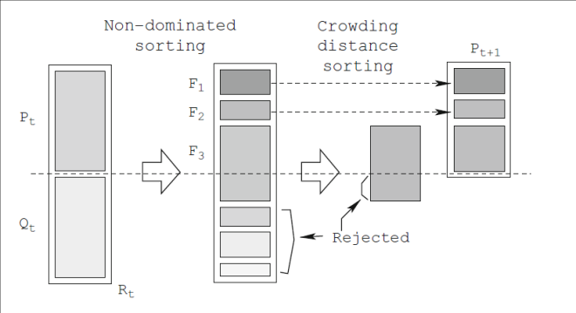
To increase some selection pressure, NSGA-II uses a binary tournament mating selection.
Each individual is first compared by rank and then crowding distance.
The crowded-sorting of the points of the last front which could not be accommodated fully is achieved in the descending order of their crowding distance values and points from the top of the ordered list are chosen.

Slide 27
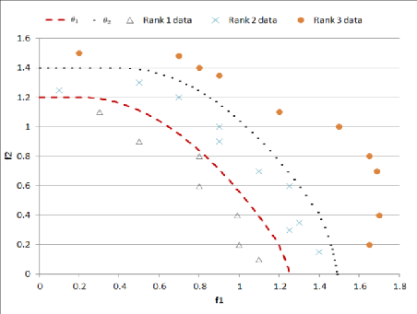
Fill new population according to front ranking.
If one front is taking partially like F3, perform Crowding-sort that uses crowding distance that is related with the density of solutions around each solution. The less dense are preferred.
Create offspring population from this new population using crowded tournament selection (It compares by front ranking, if equal then by crowding distance), crossover and mutation operators.

Slide 28
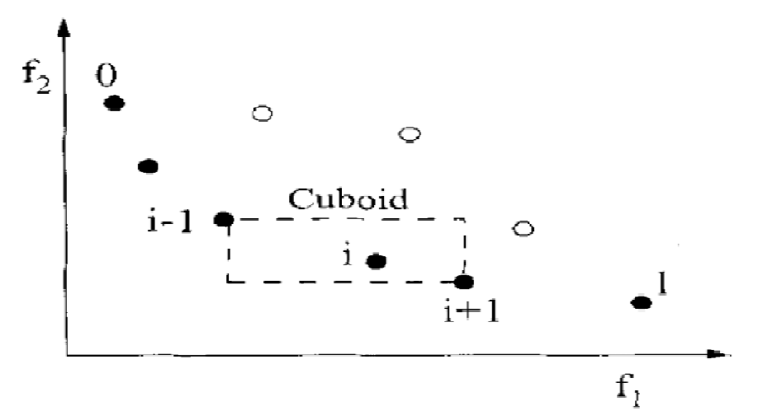
Crowding-distance calculation
The crowding distance is the Manhatten Distance in the objective space.
The crowding distance d_{i} of point i is a measure of the objective space around i which is not occupied by any other solution in the population.
Calculate d_{i} by estimating the perimeter of the cuboid formed by using the nearest neighbors in the objective space as the vertices (crowding distance).
Points marked in filled circles are solutions of the same nondominated front.
Diversity Preservation

